Slide 1
FEW-SHOT LEARNING / BEARING DIAGNOSIS
Few-Shot Bearing Fault Diagnosis
Using Model-Agnostic Meta-Learning
Replication of Zhang et al. • CWRU dataset • PyTorch
Samarth | SAP ID: 70562200011
B.Tech Artificial Intelligence & Data Science | 7th Semester
Professor: Dr. Praveen Singh Thakur
Research paper replication • B.Tech AI & Data Science
01
Notes:
Introduce the project as a practical replication of the paper, not a new algorithm. Explain that the aim is to identify bearing faults from very few labelled examples. The presentation covers the source paper, our single-notebook implementation and six completed experimental runs. Suggested duration: about 10–12 minutes. There are 16 slides including the title and references. Explain the process in order: bearing vibration, a few labelled examples, the CNN, adaptation, and measured results.
Evidence / sources:
Zhang, S., Ye, F., Wang, B., and Habetler, T. G. Few-Shot Bearing Fault Diagnosis Based on Model-Agnostic Meta-Learning. arXiv:2007.12851v4, 2021. https://arxiv.org/abs/2007.12851
Project: src/MAML_Bearing_Reproduction.ipynb; documents/IEEE_Reproduction_Paper.pdf

Slide 2
What is our project about?
We use vibration readings to identify faults in bearings.
What is a bearing?
A bearing helps a machine’s shaft rotate smoothly.
What happens when it is damaged?
Damage to the ball, inner ring or outer ring changes the vibration.
What do we want the model to do?
Recognize a new fault after seeing only a few labelled examples.
Main challenge: we may not have many examples of every possible fault.
Background: original paper, Introduction; CWRU Bearing Data Center
02
Notes:
Start with the physical problem before discussing machine learning. A bearing supports a rotating shaft and helps reduce friction. A fault in a ball or either ring changes the measured vibration. Inner race and outer race are the technical names for the inner and outer rings. Our project uses recorded vibration, not camera images. The goal is fault classification when only a few labelled examples of a new class are available. This project is an offline experiment on CWRU data, not a deployed machine-monitoring system.
Evidence / sources:
Zhang, S., Ye, F., Wang, B., and Habetler, T. G. Few-Shot Bearing Fault Diagnosis Based on Model-Agnostic Meta-Learning. arXiv:2007.12851v4, 2021. https://arxiv.org/abs/2007.12851
Case Western Reserve University Bearing Data Center. https://engineering.case.edu/bearingdatacenter/download-data-file

Slide 3
The original paper and our project
Few-Shot Bearing Fault Diagnosis Based on Model-Agnostic Meta-Learning
The paper’s main idea
Learn a good starting model that can adjust quickly to a new fault task.
The two main parts
CNN: find useful signal patterns. MAML: learn how to adapt quickly.
What we implemented
The core method on CWRU, with 3-way 5-shot and 5-way 5-shot tests.
We selected it because the method is clear and the real dataset is publicly available.
Source: Zhang, Ye, Wang and Habetler, arXiv:2007.12851v4 (2021)
03
Notes:
Name the authors: Shen Zhang, Fei Ye, Bingnan Wang and Thomas G. Habetler. We examined the June 2021 arXiv v4; its first arXiv submission was in 2020. CNN stands for convolutional neural network. MAML stands for model-agnostic meta-learning. The CNN is the classifier; MAML is the learning procedure. The paper also studies artificial-to-real transfer on Paderborn and other comparisons. We completed two CWRU five-shot configurations and did not run all paper experiments. Our implementation uses learned adaptation rates, following the corresponding version in the paper.
Evidence / sources:
Zhang, S., Ye, F., Wang, B., and Habetler, T. G. Few-Shot Bearing Fault Diagnosis Based on Model-Agnostic Meta-Learning. arXiv:2007.12851v4, 2021. https://arxiv.org/abs/2007.12851
Finn, C., Abbeel, P., and Levine, S. Model-Agnostic Meta-Learning for Fast Adaptation of Deep Networks. ICML, 2017. https://proceedings.mlr.press/v70/finn17a.html
documents/paper_analysis.md

Slide 4
What does “3-way 5-shot” mean?
A simple example: choose between three fault classes.
Fault class | Examples used to learn | Examples to predict
Outer-ring fault: 0.007 inches | 5 labelled examples | 15 test examples
Outer-ring fault: 0.014 inches | 5 labelled examples | 15 test examples
Outer-ring fault: 0.021 inches | 5 labelled examples | 15 test examples
3-way = choose between 3 classes. 5-shot = learn from 5 examples per class.
Learning examples = support set. Prediction examples = query set.
For 5-way 5-shot, we do the same process with five classes.
Evidence: notebook TaskSampler and evaluate_model
04
Notes:
This is an actual example of our 3-way test: the three outer-race fault sizes are the held-out classes. One episode, or task, has 15 labelled support examples in total and 45 queries in total. The support labels are available for the model’s one-step adjustment. Query labels are kept for scoring, not for adjustment during testing. A 5-way test has 25 support examples and 75 queries. Five-shot refers to support examples per class, not the entire training dataset. Training tasks use four queries per class because their pool contains nine examples per class.
Evidence / sources:
src/MAML_Bearing_Reproduction.ipynb: TaskSampler, evaluate_model
documents/paper_analysis.md

Slide 5
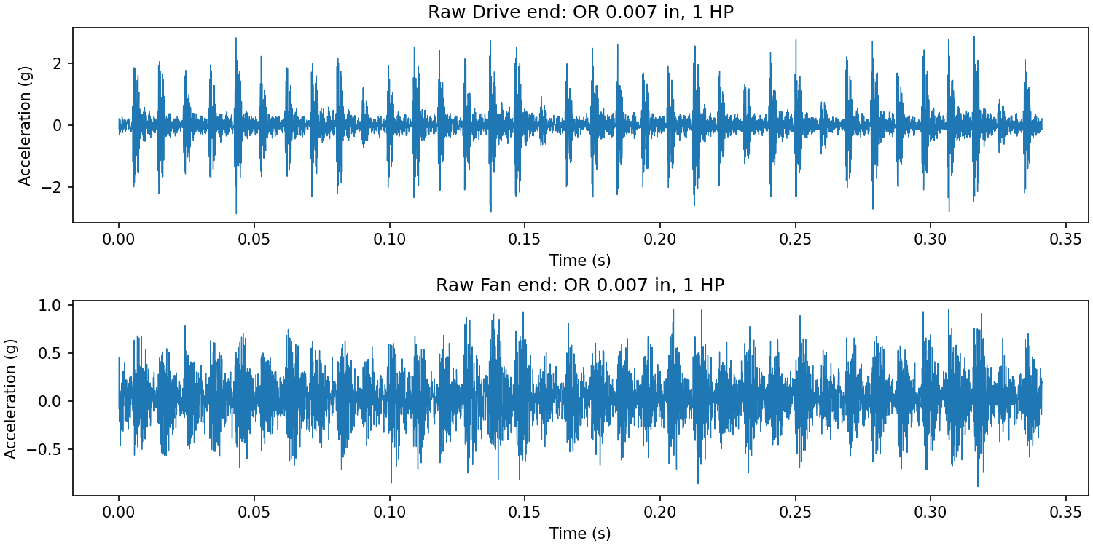
The data we used
Case Western Reserve University (CWRU): real laboratory vibration recordings
30 recordings
10 classes: healthy + 9 faults
Faults in the ball, inner ring
and outer ring
Motor loads: 1, 2 and 3 horsepower
Two sensors record the vibration: drive end (DE) and fan end (FE).
These are measured signals from deliberately damaged laboratory bearings.
Sources: data/download_manifest.csv; dataset_statistics.csv; raw_signal.png
05
Notes:
The graph is an unchanged saved output showing the drive-end and fan-end signals for one outer-race fault recording. CWRU means Case Western Reserve University. The nine fault classes combine three fault locations with three diameters: 0.007, 0.014 and 0.021 inches. There is also one healthy class. We use ten classes at three loads, giving 30 source files. The measurements are real, but the defects were seeded in laboratory bearings, so do not describe them as naturally developed industrial faults. Raw data is stored separately from the submission; exact official file IDs are in data/download_manifest.csv.
Evidence / sources:
Case Western Reserve University Bearing Data Center. https://engineering.case.edu/bearingdatacenter/download-data-file
results/figures/raw_signal.png
data/download_manifest.csv
results/tables/dataset_statistics.csv

Slide 6
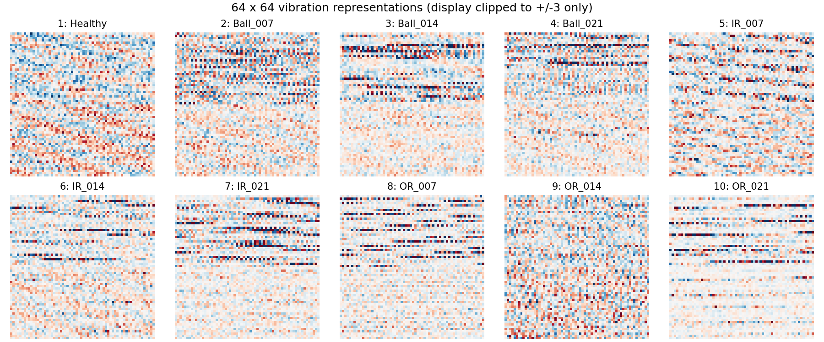
How a vibration signal becomes a model input
Each long recording is divided into small, non-overlapping pieces.
Take 2,048 values
from each sensor
Join them into
4,096 values
Put the values
on a similar scale
Arrange as a
64 × 64 grid
The grid is a reshaped signal, not a photograph. We obtained 1,771 such samples.
Evidence: notebook load_dataset and normalize_window; example_samples.png
06
Notes:
Explain each arrow. We take synchronized windows from the two sensors. Two times 2048 gives 4096 values, and 64 times 64 also gives 4096. We subtract each example’s mean and divide by its standard deviation; this is called z-score normalization. We then reshape the values into a grid that the CNN can process. The colours in the saved plot show signal values, with display clipping only; they are not camera colours. The actual inputs retain their normalized values. We use non-overlapping windows, yielding 1771 samples. Healthy recordings are treated as 48 kHz and resampled to 12 kHz; the channel rate assumption is documented. Normalization, stride and concatenation order are declared choices where paper details were incomplete.
Evidence / sources:
src/MAML_Bearing_Reproduction.ipynb: load_channels, normalize_window, load_dataset
results/figures/example_samples.png
documents/paper_analysis.md
Zhang, S., Ye, F., Wang, B., and Habetler, T. G. Few-Shot Bearing Fault Diagnosis Based on Model-Agnostic Meta-Learning. arXiv:2007.12851v4, 2021. https://arxiv.org/abs/2007.12851

Slide 7
Model architecture: the CNN
CNN (convolutional neural network): find signal patterns and predict the fault class.
Input
1 × 64 × 64
Block 1
64 × 32 × 32
Block 2
64 × 16 × 16
Block 3
64 × 8 × 8
Block 4
64 × 4 × 4
Each block: convolution → BatchNorm → ReLU → max pooling
Convolution finds local patterns. Pooling makes the grid smaller.
BatchNorm keeps feature scales stable.
ReLU keeps positive values and replaces negative values with zero.
Arrange 1,024 values in a row
Final layer: 3 or 5 class scores
Each convolution uses 64 filters of size 3 × 3. Each pooling step halves the grid.
Sources: original paper, Section III-C; notebook BearingCNN
07
Notes:
The input has one channel and spatial size 64 by 64. Each of the four blocks has a 3 by 3 convolution with 64 filters, batch normalization, ReLU and 2 by 2 max pooling. Padding of one keeps the spatial size unchanged before pooling. Four halvings give 64, 32, 16, 8, then 4. The final tensor has 64 channels times 4 times 4 positions, which equals 1024 features. A linear layer maps these features to three or five class scores; the highest score gives the prediction. Cross-entropy handles the class scores during training. CNN parameter counts are 115011 for 3-way and 117061 for 5-way; nine learned adaptation rates are additional. Padding and the precise flattened head are documented choices. The paper’s four-block CNN sequence is retained.
Evidence / sources:
Zhang, S., Ye, F., Wang, B., and Habetler, T. G. Few-Shot Bearing Fault Diagnosis Based on Model-Agnostic Meta-Learning. arXiv:2007.12851v4, 2021. https://arxiv.org/abs/2007.12851
src/MAML_Bearing_Reproduction.ipynb: BearingCNN, parameter_counts
documents/paper_analysis.md

Slide 8
How MAML teaches the model to adapt
MAML = Model-Agnostic Meta-Learning
1. Learn from a few labelled examples
Take the starting CNN and adjust its weights using the support set.
2. Check it on different examples
Use the adjusted CNN to predict the query set and calculate its errors.
3. Improve the starting CNN
Use those errors to improve the starting weights, then try another task.
At test time, only step 1 adjusts the model. Query labels are used only to score it.
Sources: Finn et al. (2017); original bearing paper; notebook MAML
08
Notes:
The important distinction is between a temporary adjustment for one task and an improvement of the shared starting model. The temporary support adjustment is the inner update. Improving the shared initialization from query loss is the outer update. We do not carry a previous test task’s adapted weights into the next task. Our implementation uses full second-order MAML, so the outer gradient passes through the inner gradient computation using create_graph=True. The mathematical idea is theta-prime equals theta minus alpha times the support-loss gradient; the outer optimization improves theta using query loss evaluated at theta-prime. Adam implements our outer update. We also learn per-layer inner learning rates, initially 0.01. These equations and details are available for questions; first explain the three plain-language steps on the slide.
Evidence / sources:
Finn, C., Abbeel, P., and Levine, S. Model-Agnostic Meta-Learning for Fast Adaptation of Deep Networks. ICML, 2017. https://proceedings.mlr.press/v70/finn17a.html
Zhang, S., Ye, F., Wang, B., and Habetler, T. G. Few-Shot Bearing Fault Diagnosis Based on Model-Agnostic Meta-Learning. arXiv:2007.12851v4, 2021. https://arxiv.org/abs/2007.12851
Antoniou, A., Edwards, H., and Storkey, A. How to Train Your MAML. ICLR, 2019. https://arxiv.org/abs/1810.09502
src/MAML_Bearing_Reproduction.ipynb: MAML

Slide 9
What we implemented in the notebook
Python + PyTorch • one notebook containing data preparation, training and testing
Load and prepare data
Choose support
and query examples
Train CNN
using MAML
Save results
and graphs
Setting | What we actually ran
Experiments | 3-way 5-shot and 5-way 5-shot
Training runs | 3 different random starts per experiment = 6 runs
Training budget | 100 updates per run; 1 task in each update
Adaptation | 1 support update; starting step size 0.01
SciPy reads the data; scikit-learn calculates metrics; Matplotlib / seaborn plot results.
Evidence: src/MAML_Bearing_Reproduction.ipynb; Config; per_seed_results.csv
09
Notes:
We implemented MAML directly with PyTorch autograd, not with a black-box MAML library. TaskSampler selects support and query examples; BearingCNN predicts class scores; MAML.adapt computes temporary weights; run_experiment trains and saves; evaluate_model scores predictions. These are functions and classes inside the one notebook, not separate project code files. Each run uses a random seed to control initialization and sampling. We used CPU with two threads. The outer optimizer is Adam with learning rate 0.001, a documented choice. Each training class provides nine examples: five support and four query. The final checkpoint is evaluated; there is no selection based on test accuracy. The paper used a substantially larger budget, which the comparison slide will explain.
Evidence / sources:
src/MAML_Bearing_Reproduction.ipynb
results/tables/per_seed_results.csv
requirements.txt
Paszke, A., et al. PyTorch: An Imperative Style, High-Performance Deep Learning Library. NeurIPS, 2019. https://papers.nips.cc/paper/2019/hash/bdbca288fee7f92f2bfa9f7012727740-Abstract.html
Kingma, D. P., and Ba, J. Adam: A Method for Stochastic Optimization. ICLR, 2015. https://arxiv.org/abs/1412.6980

Slide 10
How we tested the model
Testing checks whether the model can adapt to fault classes it did not train on.
Keep the test classes separate
3-way tests use three outer-ring faults; 5-way adds two inner-ring faults.
Give the model a small learning set
For each test task, give five labelled examples per class for adaptation.
Measure predictions on different examples
Test on 15 query examples per class. Repeat for 30 tasks in each run.
We also separate support and query windows in time. Each task starts from the same trained weights.
Evidence: split_classes, TaskSampler and evaluate_model in the notebook
10
Notes:
For 3-way, classes 1–7 are used in meta-training and classes 8–10 in testing. For 5-way, classes 1–5 are training classes and 6–10 are test classes. Source files are disjoint across these roles within each experiment. Test support comes from the earlier half of each recording and queries from the later half; one boundary window is discarded. No support sample is also a query sample in an episode. Batch-normalization uses support statistics for queries, and signal normalization is per example. Three-way has 45 query predictions per episode and five-way has 75. Thirty episodes times three seeds produce 4050 and 6750 pooled predictions respectively. These include repeated finite windows, so they are not independent bearing trials.
Evidence / sources:
src/MAML_Bearing_Reproduction.ipynb: split_classes, make_pools, TaskSampler, evaluate_model
documents/paper_analysis.md

Slide 11
Our measured results
Average percentages over three runs; ± shows variation (standard deviation).
Metric | What it measures | 3-way 5-shot | 5-way 5-shot
Accuracy | Overall correct predictions | 94.05 ± 1.20 | 58.03 ± 5.30
Precision | Correctness of predicted classes | 94.59 ± 1.35 | 64.34 ± 3.66
Recall | How many actual cases are found | 94.05 ± 1.20 | 58.03 ± 5.30
F1 score | Balance of precision and recall | 94.02 ± 1.20 | 55.60 ± 6.26
The 3-way task performed well. The 5-way task was harder and less consistent.
Source: results/tables/aggregate_results.csv
11
Notes:
Read accuracy as 94.05 percent for 3-way and 58.03 percent for 5-way. The plus/minus values are sample standard deviations across three training-seed results, not confidence intervals. Precision, recall and F1 use macro averaging: calculate a score for each class and then give every class equal weight. Balanced query classes explain why recall equals overall accuracy here. Three-way seed accuracies are 95.33, 93.85 and 92.96. Five-way seed accuracies are 58.67, 52.44 and 62.98. The class composition changes as well as the number of classes, so this is not a controlled experiment isolating only task size. All table values are taken directly from saved generated results. Training curves describe training-class performance, not these held-out test scores.
Evidence / sources:
results/tables/aggregate_results.csv
results/tables/per_seed_results.csv
results/figures/training_accuracy.png

Slide 12
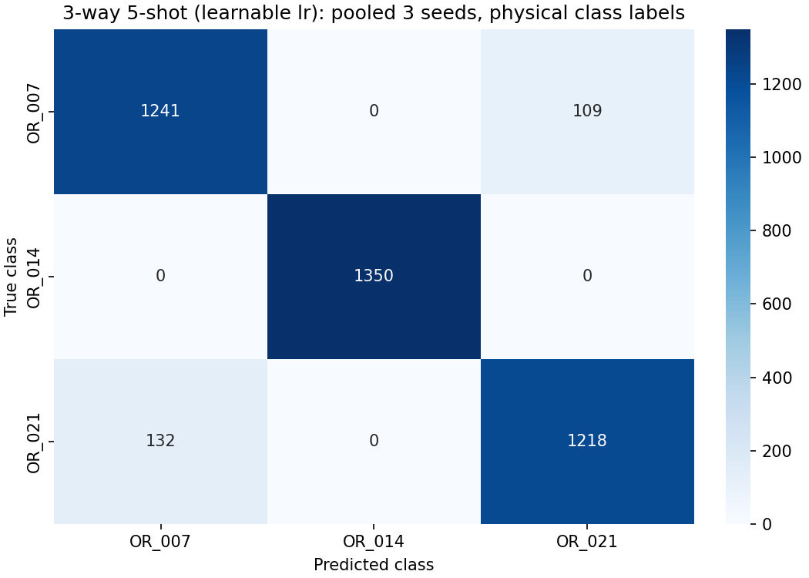
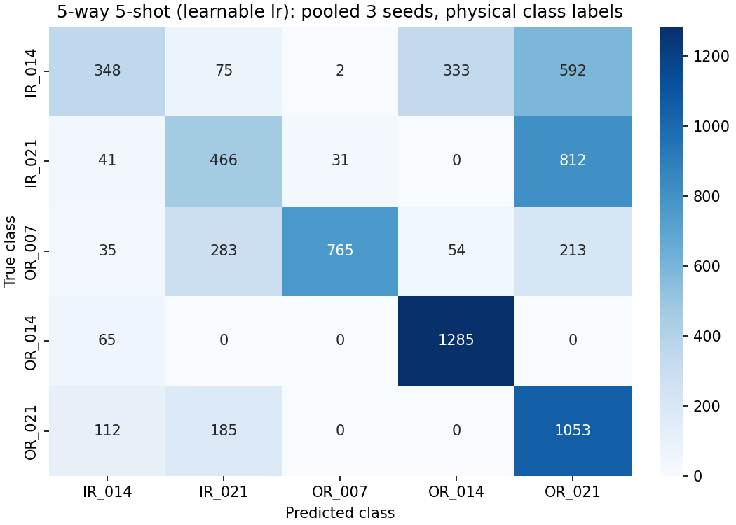
Where the model made mistakes
Confusion matrix: rows show the real class; columns show the predicted class.
3-way: most predictions are correct.
Most errors mix two outer-ring fault sizes.
5-way: inner-ring faults are often
predicted as outer-ring faults.
Sources: the project’s original saved confusion-matrix figures and CSV tables
12
Notes:
Correct predictions lie on the diagonal running from the top left to the bottom right. Values away from that diagonal are errors. IR means inner race, or inner ring. OR means outer race, or outer ring. The suffixes 007, 014 and 021 mean fault diameters 0.007, 0.014 and 0.021 inches. The left matrix pools all three 3-way runs and the right all three 5-way runs. The 3-way outer-ring 0.014 class has 100 percent recall in this evaluation only. The largest 5-way error is 812 true inner-ring 0.021 predictions labelled outer-ring 0.021. Inner-ring recall is 25.78 percent and 34.52 percent for the two held-out sizes. We have observed these mistakes but have not proven their physical cause through additional ablations.
Evidence / sources:
results/tables/confusion_matrix_3way_5shot.csv
results/tables/confusion_matrix_5way_5shot.csv

Slide 13
Our results compared with the original paper
Accuracy for the same named tasks, using MAML with learnable adaptation rates
Experiment | Original paper | Our result | Difference
3-way 5-shot | 90.36 ± 1.38% | 94.05 ± 1.20% | 3.69 points higher
5-way 5-shot | 79.98 ± 1.17% | 58.03 ± 5.30% | 21.95 points lower
Why can the numbers differ?
The paper used 1,500 training updates with 25 tasks per update.
We used 100 updates with 1 task, and different data preparation choices.
Our higher 3-way score does not prove a better method: the setups are not identical.
Sources: original paper, Table V; results/tables/paper_vs_ours.csv
13
Notes:
The comparison uses the learnable-rate MAML column from Table V, not the fixed-rate column. A difference of 3.69 points means 94.05 minus 90.36; it is a percentage-point difference, not a relative percent improvement. Five-way is 21.95 percentage points below the paper. The paper trained with 1500 iterations and 25 tasks per meta-batch and reported ten rounds; we used 100 iterations, one task and three independent training seeds. The paper reports 1980 segments per class, while our non-overlapping preprocessing yields around 177 per class. Exact stride, normalization, query counts and several architecture details required documented choices. These differences may contribute to the result gap, but we did not isolate their effects experimentally. Do not claim exact numerical reproduction or algorithmic superiority.
Evidence / sources:
Zhang, S., Ye, F., Wang, B., and Habetler, T. G. Few-Shot Bearing Fault Diagnosis Based on Model-Agnostic Meta-Learning. arXiv:2007.12851v4, 2021. https://arxiv.org/abs/2007.12851
results/tables/paper_vs_ours.csv
documents/paper_analysis.md

Slide 14
Limitations and what we would improve
These are next steps, not experiments already completed.
Current limitation | Useful next step
Short CPU training runs | Train with the original paper’s larger budget
Only two five-shot settings tested | Add one-shot tests and baseline models
Data from the same laboratory setup | Test on different bearings and Paderborn data
Some paper details are not fully specified | Compare preprocessing choices one at a time
The most important gap is the weak 5-way result; more testing is needed to explain it.
Sources: project paper; paper_analysis.md; replication_checklist.md
14
Notes:
The limited compute budget is a documented practical constraint. It is a possible reason for lower five-way accuracy, not a proven explanation. Fixed-rate MAML has gradient checks but no completed fixed-rate benchmark. One-shot tasks and Paderborn transfer were not run. Our test windows come from the same physical bearings and finite recordings, and repeated tasks reuse windows. Therefore high accuracy does not guarantee generalization to another machine. Future ablations should hold everything else constant while changing the training budget or preprocessing. Handling MATLAB sensor keys, the extra channels in file 99 and differentiating through adaptation were implementation challenges we addressed in the notebook.
Evidence / sources:
documents/paper_analysis.md
results/replication_checklist.md
documents/supplementary/reproduction_report.md

Slide 15
What we achieved and learned
We reproduced the core method and measured how well it worked.
A complete working implementation
Real CWRU data → signal preparation → CNN + MAML → tested predictions.
Measured accuracy
3-way accuracy: 94.05%. 5-way accuracy: 58.03%, with clear limitations.
The main lesson
A model can learn to adapt from a few examples, but new faults still need careful testing.
Thank you — questions are welcome.
Evidence: completed notebook, saved predictions, figures and result tables
15
Notes:
Conclude in your own words: I implemented the main learning method in one notebook and evaluated it on real recorded data. The three-way task worked well, but the five-way result was clearly below the paper, which I reported rather than hiding. I learned how support adaptation differs from the shared training update, how data separation affects evaluation, and why a paper comparison must explain different settings. For a live demonstration, open src/MAML_Bearing_Reproduction.ipynb and show samples, the model, experiment outputs and final verification. RERUN_TRAINING=False reuses saved matching runs after configuration and data checks; setting it true retrains. Use the notes as preparation, but explain the slides in simple words.
Evidence / sources:
src/MAML_Bearing_Reproduction.ipynb
results/tables/aggregate_results.csv
README.md

Slide 16
References
Main sources used for the method, dataset and implementation
[1] S. Zhang, F. Ye, B. Wang and T. G. Habetler (2021).
Few-Shot Bearing Fault Diagnosis Based on Model-Agnostic Meta-Learning.
arXiv:2007.12851v4 — arxiv.org/abs/2007.12851
[2] C. Finn, P. Abbeel and S. Levine (2017).
Model-Agnostic Meta-Learning for Fast Adaptation of Deep Networks. ICML.
proceedings.mlr.press/v70/finn17a.html
[3] Case Western Reserve University — Bearing Data Center.
engineering.case.edu/bearingdatacenter/download-data-file
[4] A. Antoniou, H. Edwards and A. Storkey (2019).
How to Train Your MAML. ICLR. arxiv.org/abs/1810.09502
Full source URLs and project evidence are also included in the speaker notes.
16
Notes:
The original bearing paper supplies the proposed method and reference results; the foundational MAML paper explains learning an initialization; the official CWRU pages supply the recordings; How to Train Your MAML provides context for learned-rate meta-learning. Additional implementation references for Adam, BatchNorm and PyTorch are listed below. Our own measured results come from local experiment files, not external papers. The generic presentation suggestions attached by the user informed the order and clarity of the slides, not the technical claims; unrelated example links and images from that attachment were not used.
Evidence / sources:
Zhang, S., Ye, F., Wang, B., and Habetler, T. G. Few-Shot Bearing Fault Diagnosis Based on Model-Agnostic Meta-Learning. arXiv:2007.12851v4, 2021. https://arxiv.org/abs/2007.12851
Finn, C., Abbeel, P., and Levine, S. Model-Agnostic Meta-Learning for Fast Adaptation of Deep Networks. ICML, 2017. https://proceedings.mlr.press/v70/finn17a.html
Antoniou, A., Edwards, H., and Storkey, A. How to Train Your MAML. ICLR, 2019. https://arxiv.org/abs/1810.09502
Case Western Reserve University Bearing Data Center. https://engineering.case.edu/bearingdatacenter/download-data-file
Kingma, D. P., and Ba, J. Adam: A Method for Stochastic Optimization. ICLR, 2015. https://arxiv.org/abs/1412.6980
Ioffe, S., and Szegedy, C. Batch Normalization. ICML, 2015. https://proceedings.mlr.press/v37/ioffe15.html
Paszke, A., et al. PyTorch: An Imperative Style, High-Performance Deep Learning Library. NeurIPS, 2019. https://papers.nips.cc/paper/2019/hash/bdbca288fee7f92f2bfa9f7012727740-Abstract.html
Local results: results/tables/aggregate_results.csv; results/tables/per_seed_results.csv; results/tables/paper_vs_ours.csv.

